Slide 1
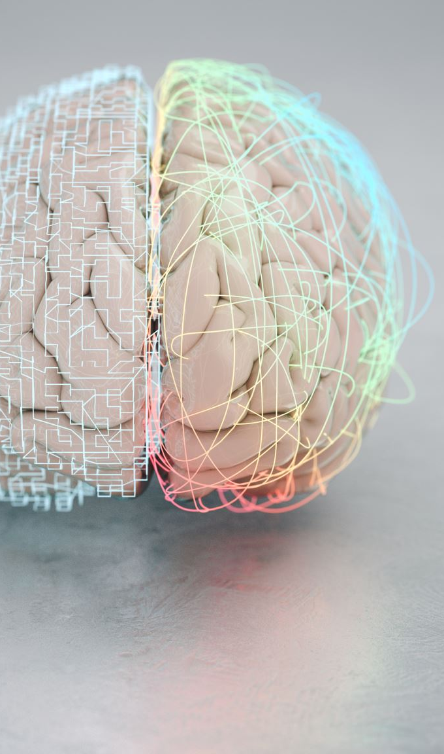
Brain Tumour Segmentation Using Deep Neural Networks

Slide 2
What is brain tumour segmentation?
Segmenting a brain tumour is the process of separating the tumour from healthy brain tissue; in typical clinical practise, this information is helpful for diagnosis and treatment planning.
Automatic brain tumour segmentation is one of the most difficult challenges in medical image processing. Developing a computational model capable of outperforming a trained human-level performance would be of great help to physicians, allowing for a more accurate, dependable, and consistent approach to illness identification, treatment planning, and monitoring.

Slide 3
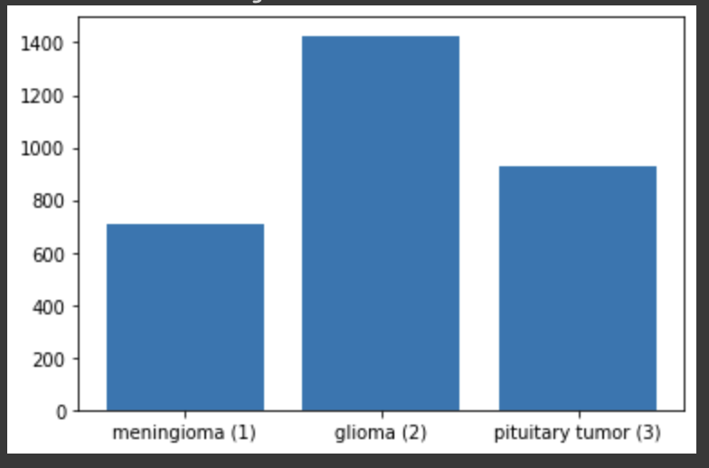
Dataset
This brain tumor dataset containing 3064 T1-weighted contrast-inhanced images from 233 patients.
This data is organized in matlab data format (.mat file)
The dataset is has 3 labels: 1 for meningioma, 2 for glioma, 3 for pituitary tumor

Slide 4
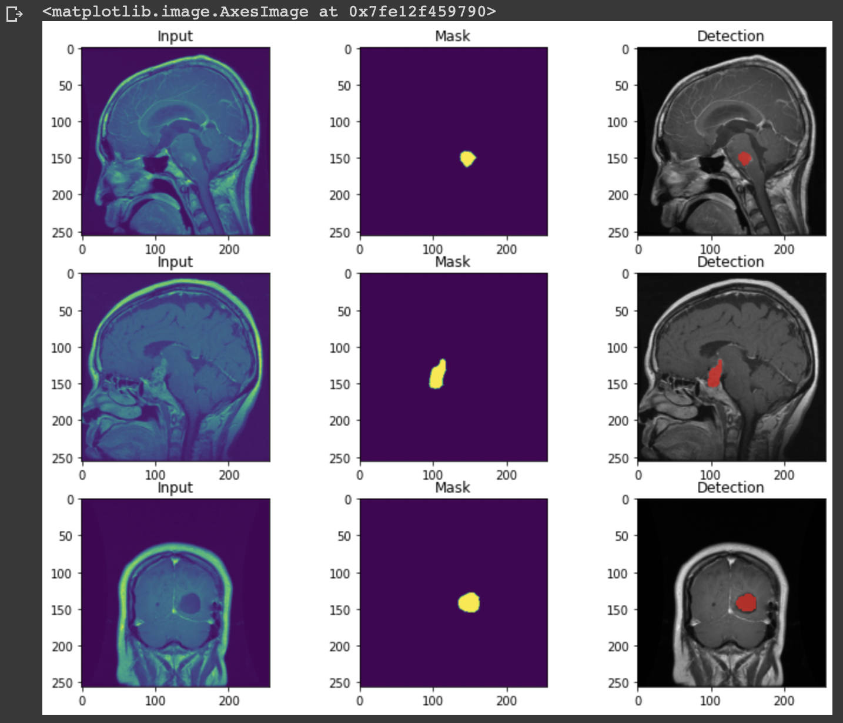
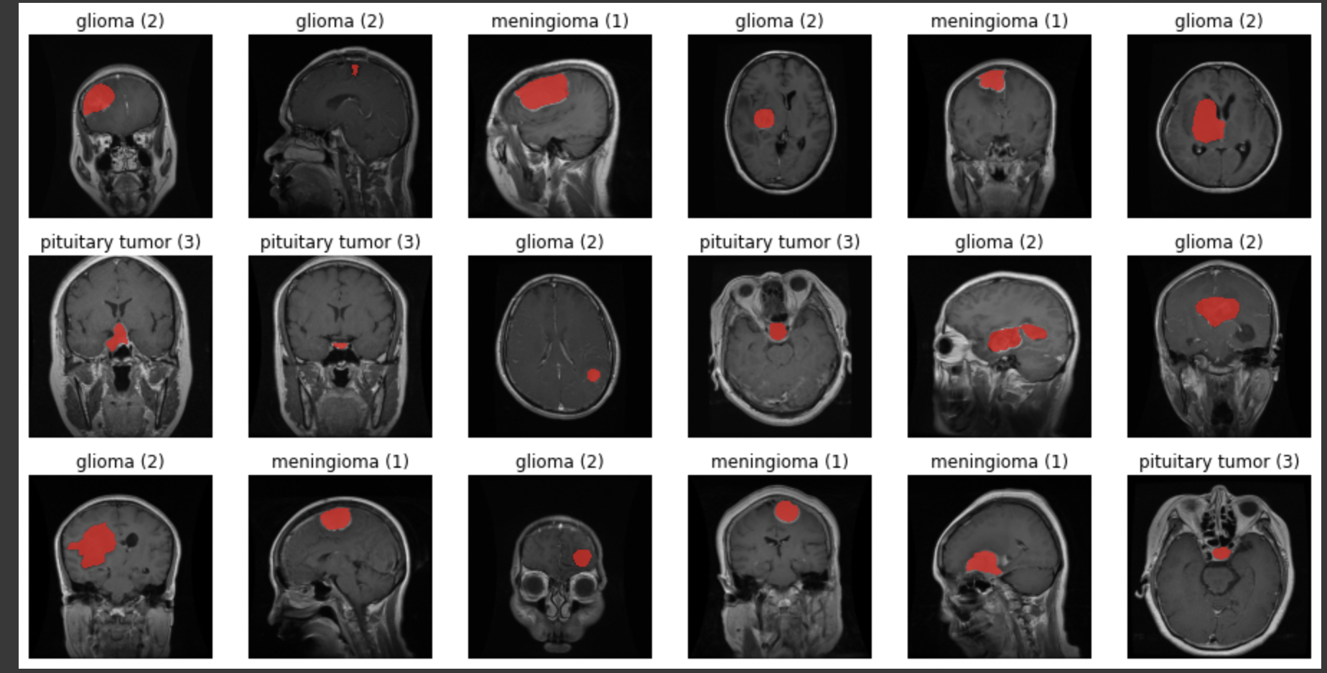
Dataset Samples

Slide 5
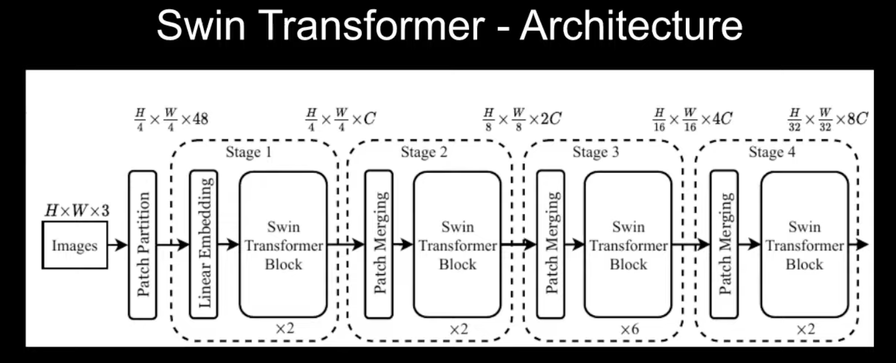
SwinUnet
It has four main components they are :-
Patch partition
Linear embedding
Swin transformer block
Patch merging
So if we understand each of these blocks then we pretty much understand the complete Architecture

Slide 6
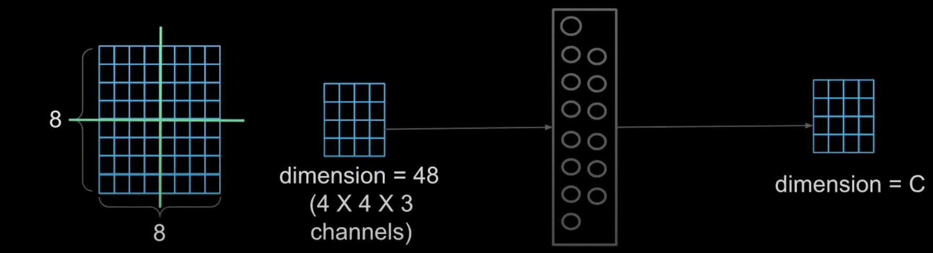
Swinunet layers
Patch partition as the name suggests the image is partitioned into several small patches so an image of size height by width with three channels is divided into non-overlapping patches or tokens .

Slide 7
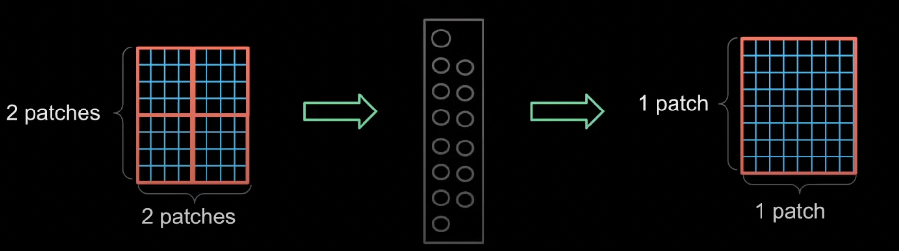
Swinunet layers
Patch merging you take the two by two neighboring patches and Merge or combine them together so that you get one patch in place of the two by two patches

Slide 8
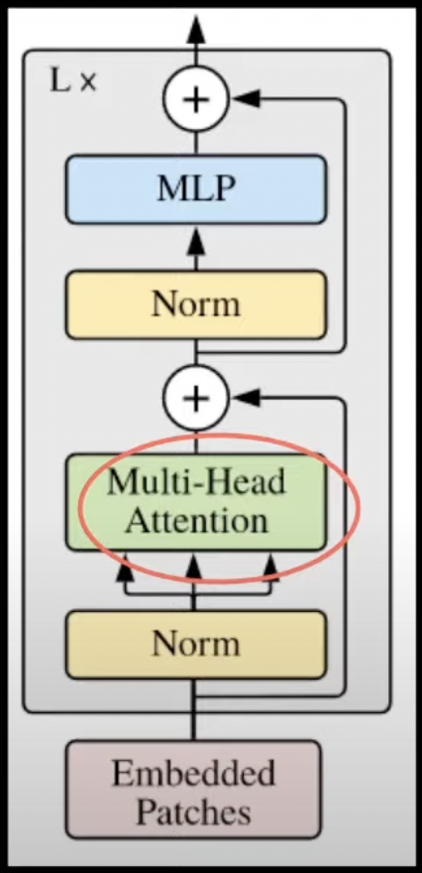
Swin Transformer block
Now we have one more main component of the network to look into and that's the swin transformer block before looking into the swin transformer block which modifies the multi-header self-attention let's look at the problem with multiheader self-attention

Slide 9
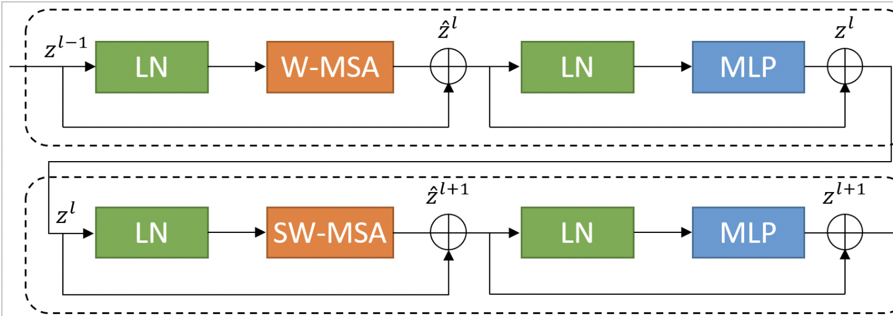
Swin-Transformer Block
So this is how a single swin transformer block looks firstly we can notice that a single layer of transformer is replaced by two layers W-MSA and SW-MSA ,W stands for window based and SW stands for shifted window so let's see what is shifted window attention now wmsa is where we divide the input image into four windows and compute attention for patches within the window

Slide 10
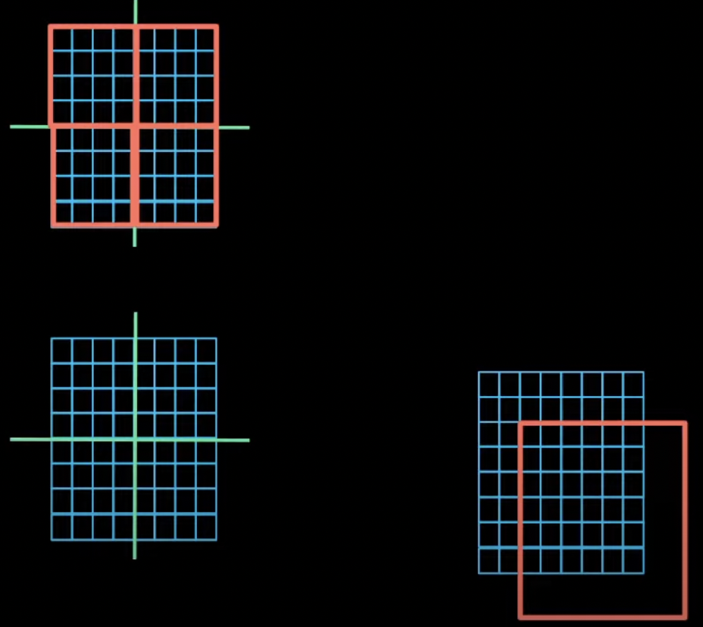
Swin transformer block
So let's see what is shifted window attention now wmsa is where we divide the input image into four windows and compute attention for patches within the window

Slide 11
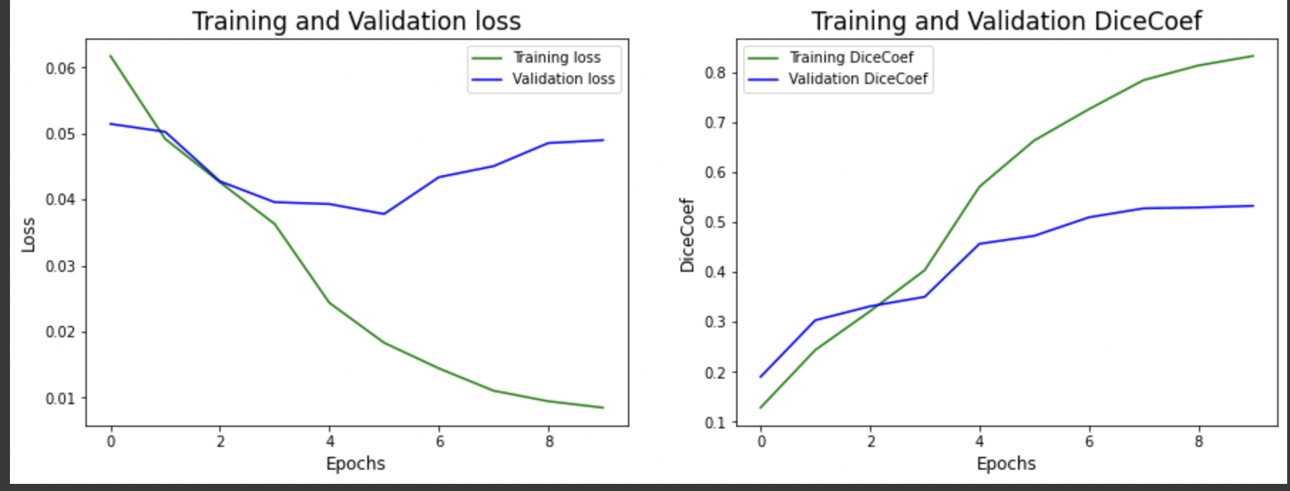
Accuracies
Training loss: 0.0085
Training dice_coef: 0.8323
Validation loss: 0.0490
Validation dice_coef: 0.5324

Slide 12
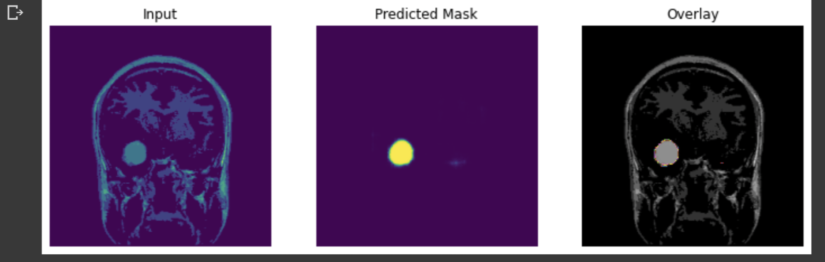
Predicted output

Slide 13
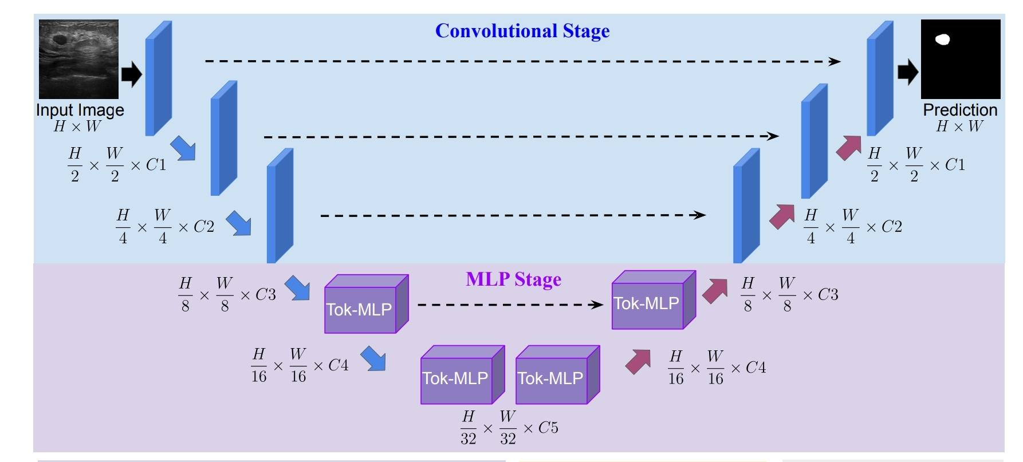
UNeXt
UNeXt is an encoder-decoder architecture with 2 main stages
Convulational stage
Tokenized MLP stage

Slide 14
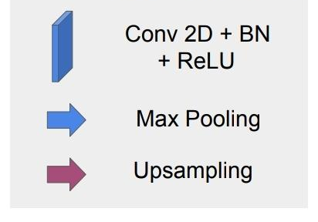
Convolutional stage
Each Convolutional block is composed 3 things
Convolutional layer
Batch normalization layer
ReLU activation

Slide 15
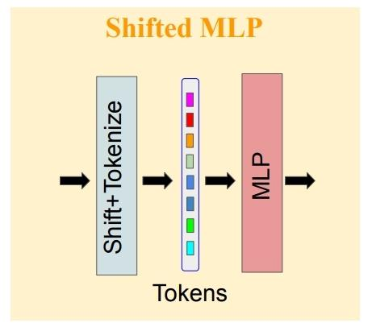
Shifted MLP
Similar to the Swin transformer. Shifted MLP
uses window shifting to induce more locality
to the global model. The tokenized MLP has 2 MLP
blocks. So we shift the features across height in
one block and acorss the width in another block.
This helps in creating random windows.

Slide 16
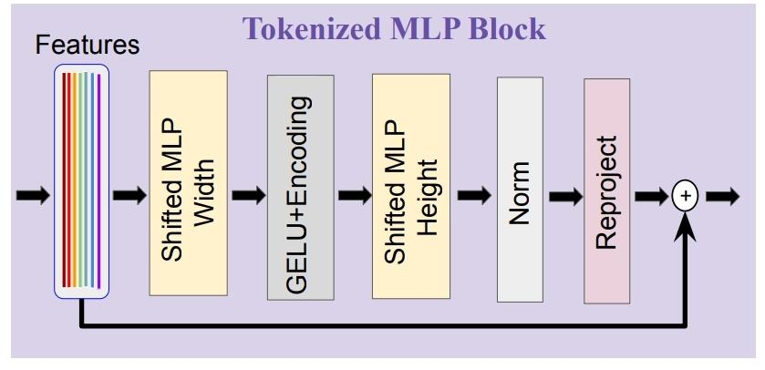
Tokenized MLP
In Tokenized MLP block.
The features are shifted and
projects the into tokens.
We pass the tokens through depth wise
convolutional layer.
we pass the features thorugh another shifted MLP
across height. Then we apply a layer normalization
and pass the output to the next block.

Slide 17
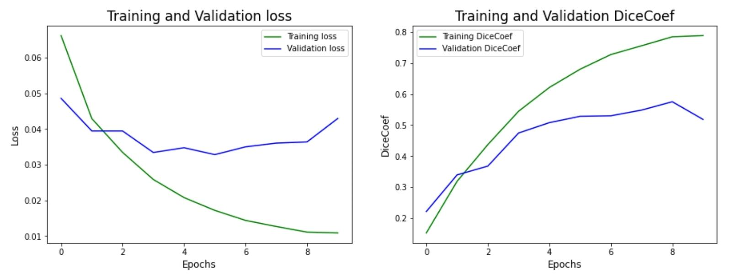
Accuracies
Training loss: 0.0109
Training dice_coef: 0.7883
Validation loss: 0.0429
Validation dice_coef: 0.5184

